Slide 1

Understanding of HPC Cluster and It's components
Notes:
1

Slide 2



Agenda
Improving computational performance
Introduction to cluster computing
Components of a cluster
Types of clusters
Question and answer
Notes:
2

Slide 3

It’s only human to “want more”
Unhappy with the computational power at their disposal
People wish to compress files and folders faster
Weather forecasting quicker and broader
Accurate predictions for financial & scientific applications
Notes:
3

Slide 4

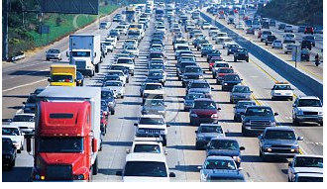
How to increase computational performance ?
Work harder - use faster & advanced hardware
Work smarter - optimize the software subsystem
! ! ! Still unhappy ! ! !
Get help - processing in parallel is the way to go
=
Notes:
4

Slide 5

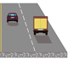
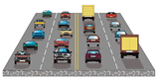
Processing in Parallel
Single Processor Parallelism
Use more pipelines
Use more cores in same die
Use of advanced extensions
Multi-Processor Parallelism - Shared memory
Use of multiple processors to speed up program run-time
By dividing up the entire computation among the processors
Notes:
5

Slide 6

Processing in Parallel - mammoth style
Multi-computer systems - Distributed memory
Uses several independent computers
Strong interconnection network
e.g. Cluster computers
Notes:
6

Slide 7


What is a cluster ?
Group of loosely coupled commodity computers
Works together to achieve the same goal
Maintains a Single System Image
Good computational performance and reliability
Good for compute Intensive, data or I/O, & transaction
Intensive applications
Homogeneous cluster and Heterogeneous
Cost-effective
Notes:
7

Slide 8
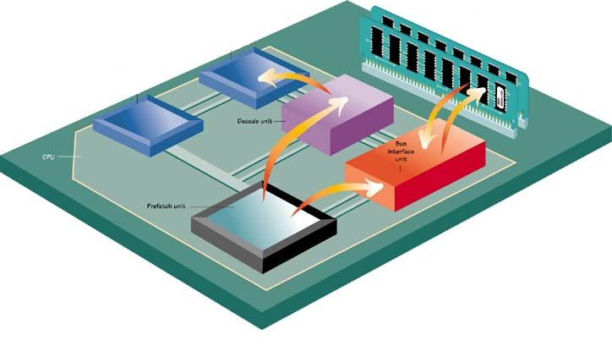
Components of a cluster computer
Software
Hardware
Network
Storage
Notes:
8

Slide 9

Cluster software
Software
Cluster compatible OS
Clustering software to generate and maintain a cluster
Cluster-aware applications
Notes:
9

Slide 10
Cluster hardware
Uses commodity components
Advanced processors with large cache
High speed memory
Advanced chipsets
Faster I/O subsystem
Notes:
10

Slide 11

Cluster network
High speed
Low-latency
Scalable
Reliable
Data throughput
Accelerators
Notes:
11

Slide 12

Cluster storage
Scratch disk
Linear scaling
Extreme bandwidth & I/O
Hierarchical Storage Management
Single storage pool
Reliable
Storage disk
Tape storage
Notes:
12

Slide 13
Types of cluster computers
LBC : Load balancing cluster
HTC : High throughput computing cluster
HAC : High availability computing cluster
HPC : High performance computing cluster
Notes:
13

Slide 14


Overview of Load balancing cluster
Notes:
14

Slide 15


Overview of HTC cluster
Focuses on completing more computations as possible
Make use of all available computing platforms
May have high latency network
May have heterogeneous nodes
Opportunistic type
Notes:
15

Slide 16

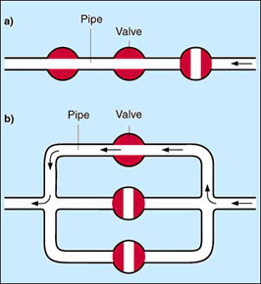
Overview of HAC cluster
Uncertainty
Failure to prepare is preparing to fail.
Mantra for High availability
Always avoid Single Point Of Failures (SPOF).
Redundancy of critical system and equipments
Notes:
16

Slide 17


Availability factor
High Availability
“a system or component that is
continuously operational”
Factors affecting High Availability
MTBF
MTTR
Outage
Downtime( Planned / Unplanned).
Notes:
17

Slide 18
Building a HPC Cluster
HPC
Notes:
18

Slide 19
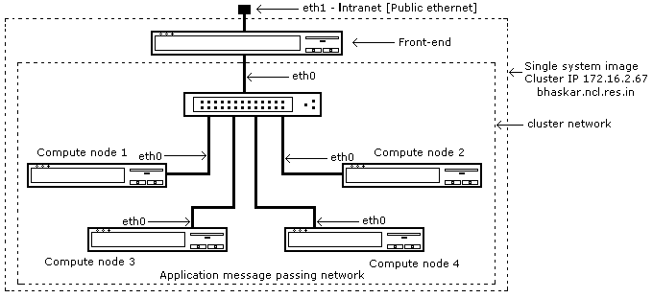
Components of HPC
Head node / Master
Compute node / Slave
Cluster software
Cluster interconnect
Cluster Storage
Software
Hardware
Network
Storage
Notes:
19

Slide 20

Parts list for a simple 1+1 HPC Cluster
Minimum Requirements
A Master node
A Slave node
Interconnection network
Instant Cluster – Live CD
Slave Nodes
1 Ethernet Port
CDROM Drive
256 MB RAM
Network
cross over network cable
Master Node
1 Ethernet port
CDROM Drive
256 MB RAM
Notes:
20

Slide 21
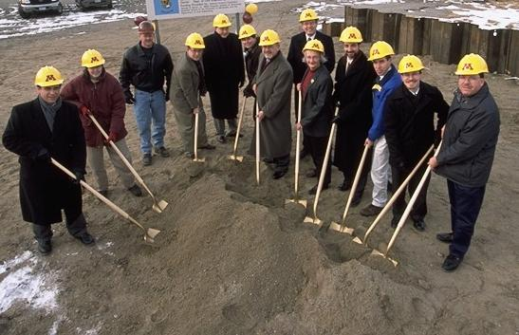

Components of HPC - Cluster software
Master – Slave arrangement
Message passing libraries
Open Mosix
Peer to peer process migration
Dynamic load balancing
clusterknoppix.sw.be
Notes:
21

Slide 22
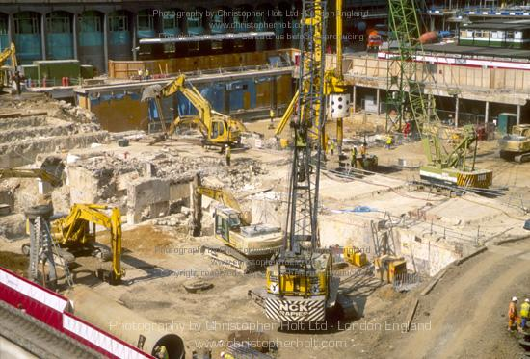
Steps in Building a Manual Cluster
Identify two or more healthy machines
Load suitable Linux & packages in to the nodes
Name the nodes appropriately and modify /etc/hosts of all nodes
Create a local area network and validate it
Identify a master node
Configure SSH and NFS daemon in master
Configure SSH daemon and NFS mount in slaves
Create identical user names / password and UID in all nodes
Notes:
22

Slide 23

Steps in Building a Manual Cluster Cont...
Copy ssh keys - password less authentication
Install mpich in master(use rsh=ssh flag).
Update 'machines' file and copy mpich to all nodes
Install SGE, PBS etc for job scheduling
Install ganglia to monitor the cluster
Export a NFS partition from the master and mount it in nodes.
Building a large manual cluster is a na na
Notes:
23

Slide 24


Building an experimental cluster using Rocks
Notes:
24

Slide 25
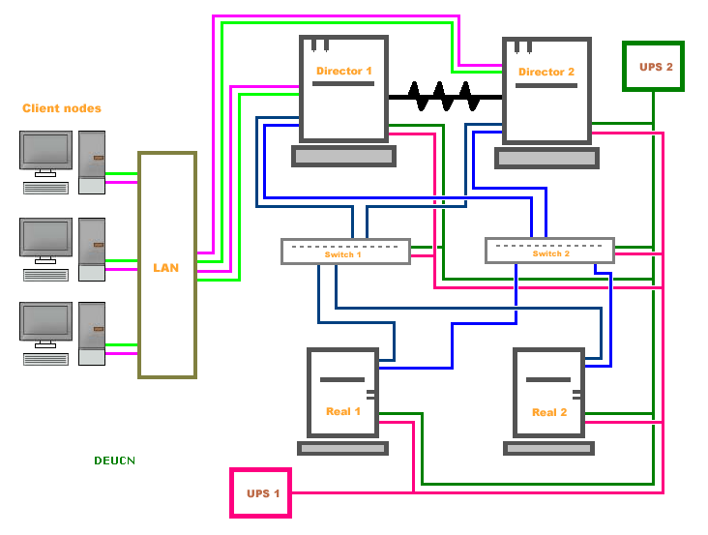
Blue print for HAC cluster
Notes:
25

Slide 26
Overview of HPC cluster
Uses advanced processors with large cache
Uses commodity components
High speed memory
Advanced chipsets
Faster I/O subsystem
High speed network
Distributed HPC
Class 1 / Class 2
Notes:
26

Slide 27
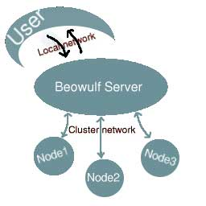
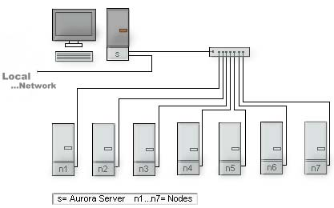
Blue print for HPC cluster
System Name : Tianhe-1A
Site : National Supercomputing center in Tianzin
Cores 186368
Memory 229376 GB
R Max GFlops 2566000
R Peak Gflops 4701000
Operating System Linux
Processor : Intel EM64T Xeon X56xx (Westmere-EP) 2930 MHz (11.72 Gflops)‏
List Rank Rmax (GFlops)‏
11/2010 1 2.566e+06
Notes:
27

Slide 28
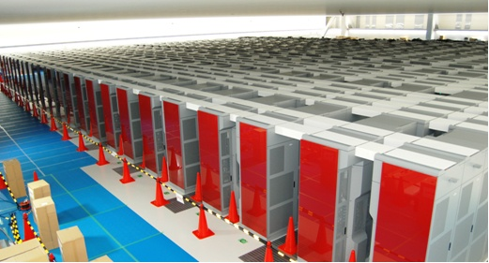
K computer, SPARC64 VIIIfx 2.0GHz, Tofu interconnect - Japan
Site: RIKEN Advanced Institute for Computational Science (AICS)
List Rank System Vendor Total Cores Rmax(GFs) Rpeak(GFs) Power (Kw)
11/2011 1 K computer, SPARC64 VIIIfx 2.0GHz, Tofu interconnect Fujitsu 705024 10510000.00 11280384.00 12659.89
06/2011 1 K computer, SPARC64 VIIIfx 2.0GHz, Tofu interconnect Fujitsu 548352 8162000.00 8773632.00 9898.56
Notes:
28

Slide 29

Notes:
29

